Slide 1
Global Optimisation
Dr G Sudha Sadasivam

Slide 2
A data-flow value for a program point represents an abstraction of the set of all possible program states that can be observed for that point
IN[s] and OUT[s]: data-flow values before and after each statement s
The data-flow problem is to find a solution to a set of constraints on IN[s] and OUT[s], for all statements s
A DFAschema consists of
A control-flow graph
A direction of data-flow (forward or backward)
A set of data-flow values
A confluence operator (normally set union or intersection)
Transfer functions for each block

Slide 3
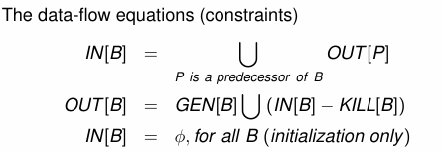
We kill a definition of a variable a, if between two points along the path, there is an assignment to a
A definition d reaches a point p, if there is a path from the point immediately following d to p, such that d is not killed along that path
if (a==b) a=2; else if (a==b) a=4;
both a=2 and a=4 are reaching definitions
P1
P2
Pn
B

Slide 4
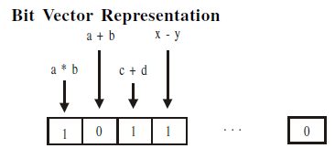
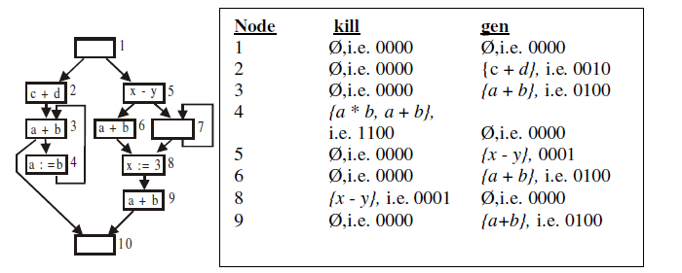

Slide 5
Data flow information of a node
1. Data flow information generated in a node. Here, an expression becomes available following its computation in the node.
2. Data flow information killed in a node. Here, a definition of variable ‘v’ kills all expressions involving ‘v’.
3. Data flow information obtained from neighboring nodes. A definition reaching the exit of a predecessor also reaches the entry of a node
Meet over Paths – information from multiple paths to a point P are merged (node 10)

Slide 6
Dataflow problems
Data Flow Problem | Generated Information | Killed Information | Merge
Available Expressions | Downwards exposed | Redefining the l-value of expressions / assigning values kills the previous information | ∩
Reaching Definitions | Downwards exposed | Redefinitions kills the previous definitions | U
Live variables | Upwards exposed | Redefining the variable / assigning values kills the variable | U
Very Busy Expressions | Upwards exposed | Redefining the l-value of expressions kills expressions using it. | ∩

Slide 7
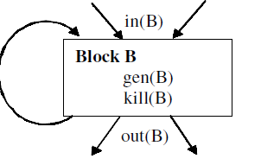
out[S] = gen[S] U (in[S] - kill[S])
1) Simple statement
gen[S] = {d}
kill[S] = D_{a}-{d}
out[S] = gen[S] U (in[S] – kill[S])
D_{a} is the set of all definitions of a in TAC
S
d: a:= b+c

Slide 8
2) Sequence flow statement
gen[S] = gen[S2] U (gen[S1] – kill [S2])
kill[S] = kill[S2] U (kill[S1] – gen [S2])
in[S1] = in[S]
in[S2] = out[S1]
out[S] = out[S2]
S1
S
S2
3) Decision / alternative flow statement
gen[S] = gen[S1] U gen[S2]
kill[S] = kill[S1] ∩ kill[S2]
in[S1] = in[S]
in[S2] = in[S]
out[S] = out[S1]U out [S2]
S
S1
S2

Slide 9
4) Looping statement
S
gen[S] = gen[S1]
kill[S] = kill[S1]
in[S1] = in[S] U gen[S1]
out[S] = out[S1]
S1

Slide 10
Ud-chain – use definition
d1: I = 2
d2: J = I + 1
B1
d3: I = 1
B2
d4: J = J + 1
B3
d5: J = J - 4
B4
B5
Block | Gen(B) | Bit Vector (Gen) | Kill(B) | Bit Vector (Kill)
B1 | {d1,d2} | 11000 | {d3,d4,d5} | 00111
B2 | {d3} | 00100 | {d1} | 10000
B3 | {d4} | 00010 | {d2, d5} | 01001
B4 | {d5} | 00001 | {d2, d4} | 01010
B5 | Ø | 00000 | Ø | 00000

Slide 11
in[B1]=out[B2]=gen[B2]={d3}🡪 00100.
out[B1] = in[B1] – kill[B1] U gen[B1]
={d3}–{d3,d4,d5}U {d1,d2} = Ø U {d1,d2} 🡪 11000
in[B3] = out[B2] = {d2,d3}. 01100.
out[B3] = in[B3] – kill[B3] U gen[B3]
={d2,d3}–{d2,d5} U {d4} = { d3,d4}. 00110
in[B2]=out[B1]Uout[B5]= {d1,d2} U Ø = 11000
out[B2] = in[B2] – kill[B2] U gen[B2]
= {d1,d2} – {d1} U {d3}= { d2, d3}.🡪 01100
in[B4] = out[B3] = {d3,d4}. 00110.
out[B4] = in[B4] – kill[B4] U gen[B4]
= {d3,d4}–{d2,d4}U{d5} = { d3,d5}. 00101
d1: I = 2
d2: J = I + 1
B1
in[B5] = out[B4] U out[B3]={d3,d4,d5}. 00111.
out[B5] = in[B5] – kill[B5] U gen[B5]
= {d3,d4,d5} – Ø U Ø= { d3,d4,d5}.00111.
d3: I = 1
B2
 | (Gen) | (Kill)
B1 | 11000 | 00111
B2 | 00100 | 10000
B3 | 00010 | 01001
B4 | 00001 | 01010
B5 | 00000 | 00000
d4: J = J + 1
B3
Block | Initial |  | Pass1
 | in[B] | out[B] | in[B] | out[B]
B1 | 00000 | 11000 | 00100 | 11000
B2 | 00000 | 00100 | 11000 | 01100
B3 | 00000 | 00010 | 01100 | 00110
B4 | 00000 | 00001 | 00110 | 00101
B5 | 00000 | 00000 | 00111 | 00111
d5: J = J - 4
B4
B5

Slide 12
Pass1 |  | Pass2 |  | Pass3
in[B] | out[B] | in[B] | out[B] | in[B] | out[B]
00100 | 11000 | 01100 | 11000 | 01111 | 11000
11000 | 01100 | 11111 | 01111 | 11111 | 01111
01100 | 00110 | 01111 | 00110 | 01111 | 00110
00110 | 00101 | 00110 | 00101 | 00110 | 00101
00111 | 00111 | 00111 | 00111 | 00111 | 00111
d1: I = 2
d2: J = I + 1
B1
d3: I = 1
B2
 | (Gen) | (Kill)
B1 | 11000 | 00111
B2 | 00100 | 10000
B3 | 00010 | 01001
B4 | 00001 | 01010
B5 | 00000 | 00000
d4: J = J + 1
B3
out[B1] = in[B1] – kill[B1] U gen[B1]
d5: J = J - 4
B4
B5

Slide 13
B | in[B] | out[B]
B1 | 01111 | 11000
B2 | 11111 | 01111
B3 | 01111 | 00110
B4 | 00110 | 00101
B5 | 00111 | 00111
d2 uses I, while d4 and d5 uses J. T
To compute ud-chain,
If Use of a var is preceded by def in same block then only last definition reaches the use. Eg I in B1 – def is d1 and use is d2.
If Use of a var is not preceded by def in same block (B) , all def of the var in in[B] ie {01111} = {d2,d3,d4,d5}. But d3 does not define J. Hence the ud-chain for J in block B3 is {d2,d4,d5}.
To find ud-chain for J in B4, in[B4] is found. It is {00110}={d3,d4}. As d3 does not define J, the ud-chain for J in d5 is {d4}
d1: I = 2
d2: J = I + 1
B1
d3: I = 1
B2
UD-Chain
d4: J = J + 1
B3
d5: J = J - 4
B4
B5

Slide 14
Next use information
live(a) = true, live(b) = true, live(t) = true,
nextuse(a) = none, nextuse(b) = none, nextuse(t) = none
Statement i: a := b + c
live(a) = false nextuse(a) = none
live(b) = true nextuse(b) = i
live(c) = true nextuse(c) = i
live(t) = false nextuse(t) = none
Statement j: t := a + b
live(a) = true nextuse(a) = j
live(b) = true nextuse(b) = j ,
live(t) = false nextuse(t) = none

